Slide 1
Cyber Security in Higher Education
James
Emily
Jonathan

Slide 2
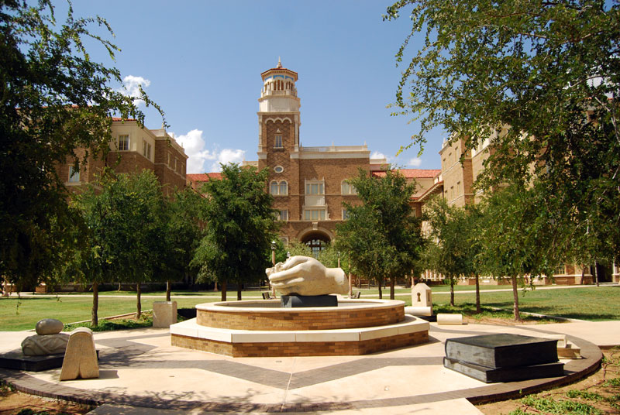
Introduction and Industry Background
Industry: Higher Education
Degree programs, Research, and Student Services
Courses, accreditation, educational materials, and labs
Providing students with food, dormitories, doctor visits, tutoring, and other miscellaneous services
Notes:
Jonathan

Slide 3
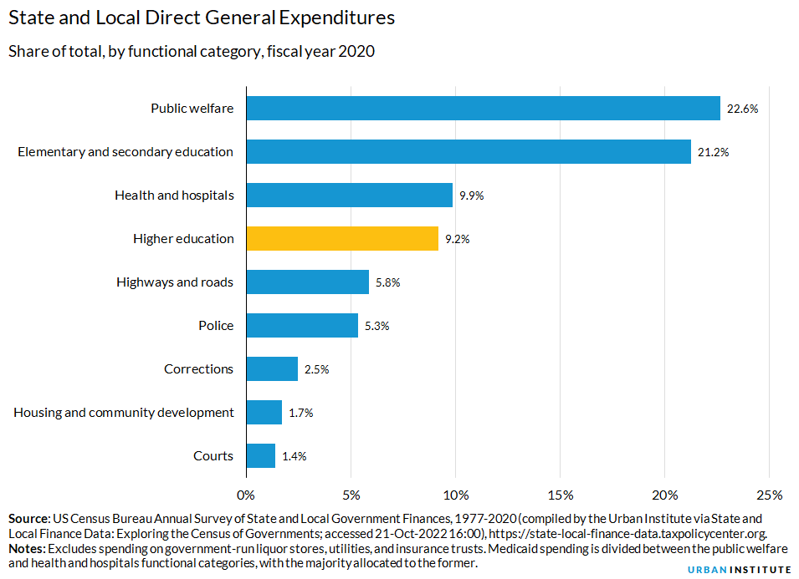
Size and Major Industry Players
6.4% of the U.S. GDP is spent on education from both private and public sources in 2020
There are approximately 11.51 million students (about twice the population of Arizona) enrolled in higher education in 2023
4000 degree granting academic institutions
Notes:
Jonathan

Slide 4

Importance of Information Technology
Databases are used to hold student data like grades, identifying information, classes/schedules, and contact information
valuable research information can be held within university databases
These are both targets for cyberattacks due to the value they could provide to the attacker
Notes:
Jonathan

Slide 5
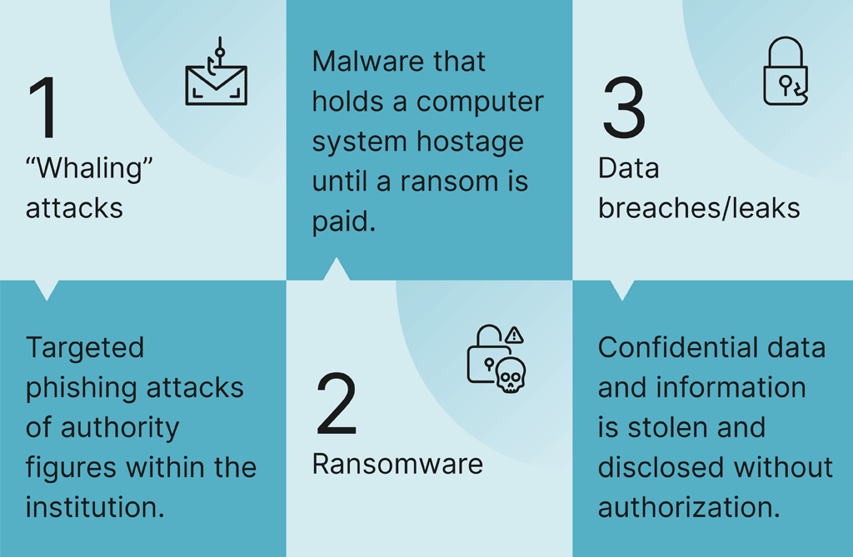
Relevant Threat Trends
Phishing attacks, ransomware attacks, and credential theft are the top 3 threats to the education industry.
Notes:
Emily

Slide 6

Relevant Threat Trends
While it is essential for modernization that the education industry continues to adopt new technologies and cloud services, the dependence on it continues to introduce additional vulnerabilities.
Appealing targets of attacks are academic databases, intellectual property, and login credentials.
These attacks disrupt learning, compromises proprietary information, and can lead to identity theft and financial fraud.
Notes:
Emily

Slide 7
Critical Asset Identification
Learning Management System
University Websites
Personal Devices Connected to University Networks
University Networks
Productivity Software Suites
Notes:
James

Slide 8


Critical Asset Identification – TTU Example
Learning Management System
Blackboard
University Websites
Raiderlink
Personal Devices Connected to University Networks
Student/Professor Laptops
University Networks
TTU WIFI
Productivity Software Suites
Microsoft Office 365 (SharePoint, MS Teams, etc.)
Notes:
James

Slide 9
Threat Scenarios

Slide 10
Personal Devices – Social Engineering
Adversary: Student gaining access to another student’s personal device with the goal of impersonating them to get sensitive information.
Capabilities: The adversary would have knowledge of social engineering techniques, phishing skills, or could possibly be informed on malware development and deployment.
Infrastructure: The infrastructure would be the adversary's communication channels, such as email, phone calls, social media, or in-person interactions, used to establish contact with potential victims.

Slide 11
Learning Management System – Injection Attacks
Adversary: Current student or students at a university trying to gather data of their classmates.
Capabilities: SQL-Injection, Cross-Site-Scripting Vulnerabilities.
Infrastructure: The LMS itself. Injection attacks directly exploit vulnerabilities in websites or applications without needing external networks or assets. Attackers inject malicious code into input fields, manipulating functionality to compromise data or execute unauthorized commands within the system itself.
Victim: Not only the university the student attends. All universities using the LMS would be put at risk. Therefore, every student at each of these universities could possibly be the victims.

Slide 12
Productivity Software Suites – Phishing
Adversary: A cybercriminal organization specializing in identity theft and email-compromising schemes.
Capabilities: Targeted phishing campaigns to trick users into revealing their Microsoft login credentials, enabling unauthorized access to email accounts and sensitive documents.
Infrastructure: The adversary operates from temporary email addresses, compromised websites, and phishing landing pages designed to mimic legitimate Microsoft login portals.
Victim: Students, faculty, and administrative staff using Microsoft Suite services for email communication, document collaboration, and administrative tasks.

Slide 13
Intelligence Buy-In
Higher education institutions experience security breaches relatively frequently, and with a concerning 20% increase in breaches from 2022 to 2023.
The cost of a data breach is substantial; universities must cover remediation costs, legal fees associated data protection regulations, and the loss of valuable intellectual property.
On average, universities end up facing a financial burden of $3.65 million per breach.
Intelligence-based security can facilitate early detection, rapid response, and proactive risk management protocols. This will not only minimize the impact of breaches, but also will ultimately reduce the financial costs associated with them.
Notes:
Emily

Slide 14
Dataset Identification & Justification

Slide 15
Spam Assassin Dataset
Retrieved from Kaggle.com
Spam is a constant issue for Education with bad actors usually targeting educational institution through the vector of email spam
Successfully identified spam will allow these emails to be automatically quarantined, increasing the overall security of the educational institution
This data source was selected due to its generous length allowing for effective text analysis and for the data's cleanliness/ease of use
Notes:
Jonathan

Slide 16
Phishing Link Dataset
Retrieved from Kaggle.com
This data set includes various features of links contained within emails
Each row is labeled as either a phishing link or a legitimate one
Will allow us to create a model that can classify whether a given link is a phishing link or not
The classification of phishing links are valuable to the industry of Education as these models can be utilized to automatically block emails containing dangerous phishing links
Notes:
Jonathan

Slide 17
Collection & Parsing Strategies

Slide 18
Spam Assassin
The dataset relating to spam mail detection is the SpamAssassin dataset, a popular collection of emails labeled as either spam or ham (non-spam).
Data was obtained through both user contributions and web scraping.
The text contents and meta data of the emails were parsed into one column of csv file, with another column being the email's classification.
Notes:
Emily

Slide 19
Phishing Links
Webpages labeled as phishing came from URLS found on PhishTank and OpenPhish, two collaborative platforms that collect and distribute data related to phishing attacks. Like the SpamAssassin database, these platforms rely on manual user submissions and automated web scrapers.
Legitimate webpages were collected from Alexa and the Common Crawl archive.
This data is parsed into a CSV as well, with columns denoting different features of the webpage and the page’s phishing classification.
Notes:
Emily

Slide 20
Data Summary – URL Phishing Detection
NumDots
SubdomainLevel
PathLevel
UrlLength
HostnameLength
PathLength
QueryLength
DoubleSlashInPath
NumNumericChars
URL STRUCTURE METRICS:
These metrics focus on the structural aspects of the URL, such as the number of dots in the URL, the level of subdomains, the depth of the path, and the overall length of the URL components (hostname, path, query). These metrics provide insights into the complexity and organization of the URL itself.

Slide 21
Data Summary – URL Phishing Detection
NumDash
NumDashInHostname
AtSymbol
TildeSymbol
NumUnderscore
NumPercent
NumQueryComponents
NumAmpersand
NumHash
URL CHARACTER COUNTS AND SYMBOLS:
This bin includes metrics that count specific characters like dashes, underscores, percentages, query components, ampersands, and hashtags within the URL. It also checks for the presence of symbols like "@" and "∼." These metrics help identify patterns or unusual characters in the URL.

Slide 22
Data Summary – URL Phishing Detection
NoHttps
HttpsInHostname
IpAddress
DomainInSubdomains
DomainInPaths
InsecureForms
RelativeFormAction
ExtFormAction
AbnormalFormAction
SECURITY CHECKS:
These metrics focus on security-related aspects and protocol checks within the URL. They check for HTTPS usage, presence of an IP address, domain structure in subdomains and paths, as well as the security status of form actions (HTTPS, relative URLs, external domains, abnormal actions).

Slide 23
Data Summary – URL Phishing Detection
NumSensitiveWords
EmbeddedBrandName
PctExtHyperlinks
PctExtResourceUrls
ExtFavicon
PctNullSelfRedirectHyperlinks
FrequentDomainNameMismatch
FakeLinkInStatusBar
RightClickDisabled
PopUpWindow
SubmitInfoToEmail
IframeOrFrame
MissingTitle
ImagesOnlyInForm
CONTENT ANALYSIS:
This bin covers metrics related to content analysis and link behavior. It includes counts of sensitive words in the URL, presence of brand names, percentages of external hyperlinks and resource URLs, favicon sourcing, abnormal hyperlinks (self-redirects, null values), domain name mismatches, and various HTML-related checks (fake links, right-click disable, pop-ups, mailto forms, iframes).

Slide 24
Data Summary – URL Phishing Detection
CLASS_LABEL
Classification of the URL (1 = phishing email
A more detailed data dictionary is included in milestone 2 appendix

Slide 25
Data Summary – Spam Email Detection
Name | Description | Null Count | Distinct Count | Min | Max
text | Contains the components of the email such as sender information, recipient information, email metadata, email content, signature, footer, etc. | 0 | 5826 | N/A | N/A
target | 1 if spam email 0 if ham email | 0 | 2 | 0 | 1

Slide 26
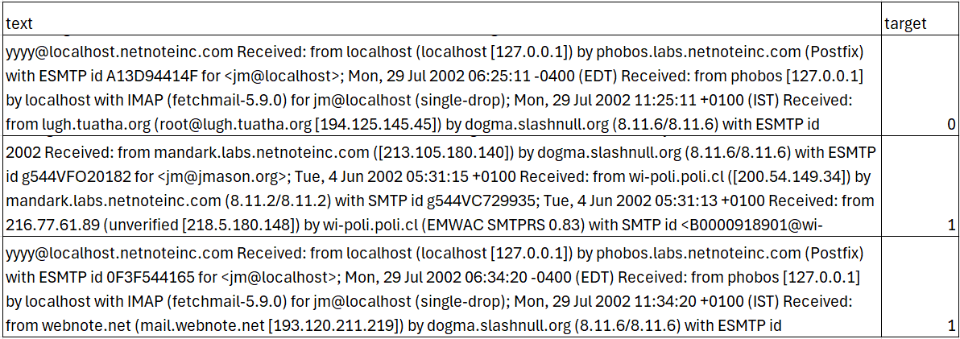
Data Summary – Spam Email Detection

Slide 27
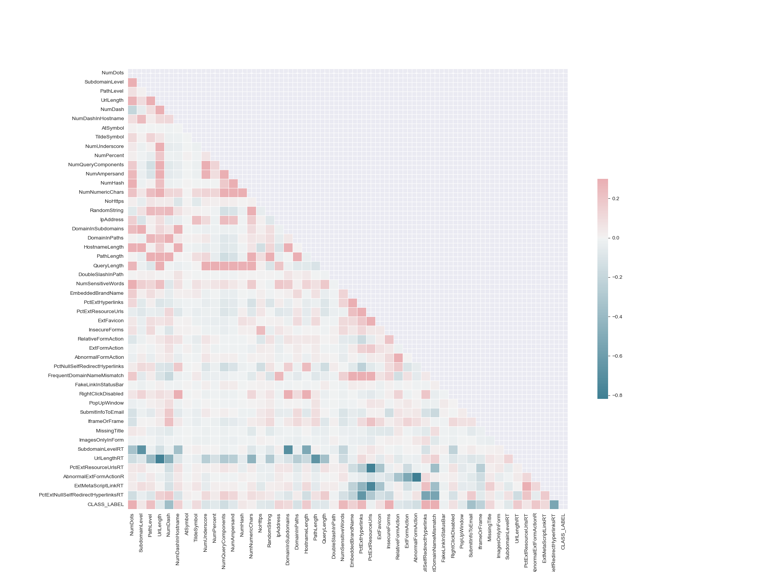
Observations on Data Patterns – URL Phishing Detection

Slide 28
Observations on Data Patterns – URL Phishing Detection

Slide 29
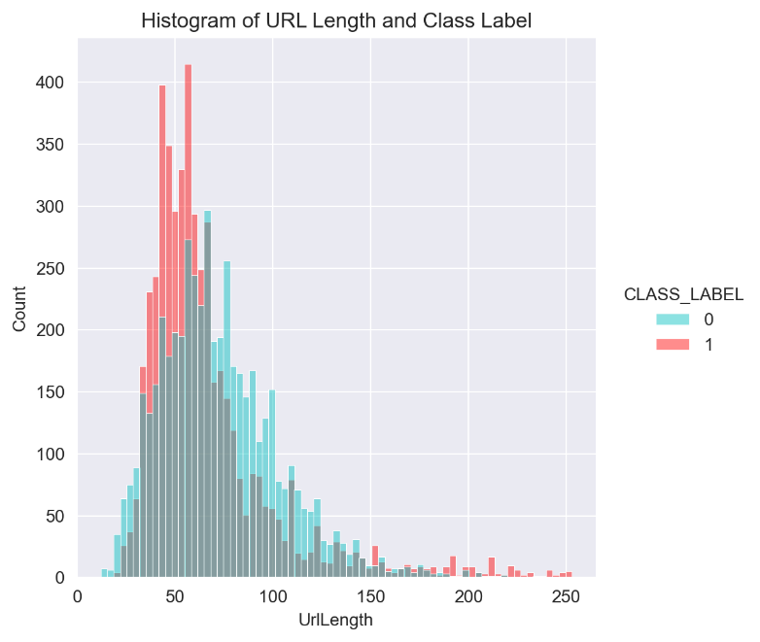
Observations on Data Patterns – URL Phishing Detection
we can see that phishing URLs (denoted by CLASS_LABEL = 1 and the color red) are typically shorter than non-phishing URLs

Slide 30
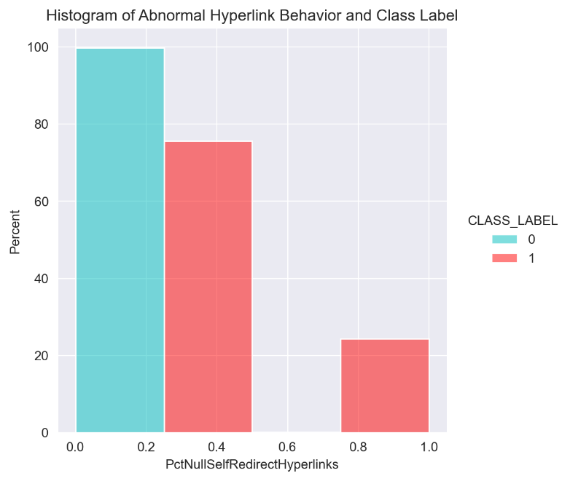
Observations on Data Patterns – URL Phishing Detection
Nearly all the non-phishing links had less than 50% of hyperlinks fields containing an empty value, a self-redirect value such as “#”, the URL of the current webpage, or some abnormal value such as “file://E:/”. In other words, non-phishing links typically have less than half of their hyperlinks missing or pointing to unusual places.
Notes:
On the other hand, nearly 25% of all phishing URLs had a majority of their internal URLs have an empty value, a self-redirect value, the URL of the current webpage, or some abnormal value

Slide 31
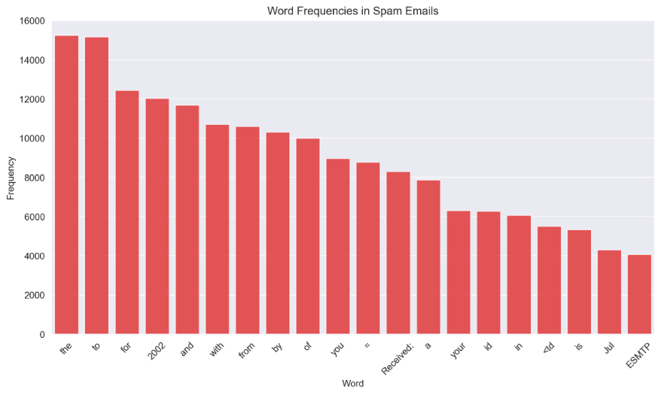
Observations on Data Patterns – Spam Email Detection
Notes:
most common words were words like “the”, “to”, and “for” which lack discriminatory power and are not specific to any topic or category
we learned that many of the most frequent terms/words were words containing information about the email metadata

Slide 32
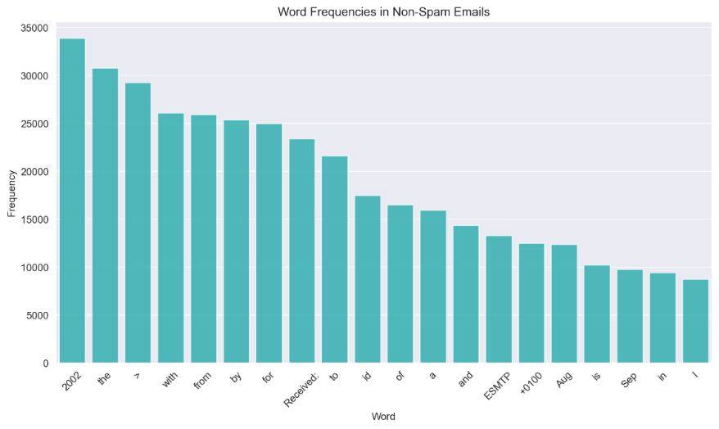
Observations on Data Patterns – Spam Email Detection
Notes:
most common words were words like “the”, “to”, and “for” which lack discriminatory power and are not specific to any topic or category
we learned that many of the most frequent terms/words were words containing information about the email metadata
many of the words that were most frequent turned out to be HTML characters, such as “>”, “<”, or “id”

Slide 33
Artifact Selection & Creation Process

Slide 34
Artifact One: Text Analysis of Email Spam
Text analysis was determined to be the best artifact for the Spam Assassin dataset as generating a data frame of the frequency of word use in emails would allow us to build a text vectorization model for detecting spam.
Detecting spam is valuable for protecting the industry of education as spammed emails are a major vector for unleashing different types of cyberattacks such as phishing links, ransomware, general malware, and even various scams
Notes:
Jonathan

Slide 35
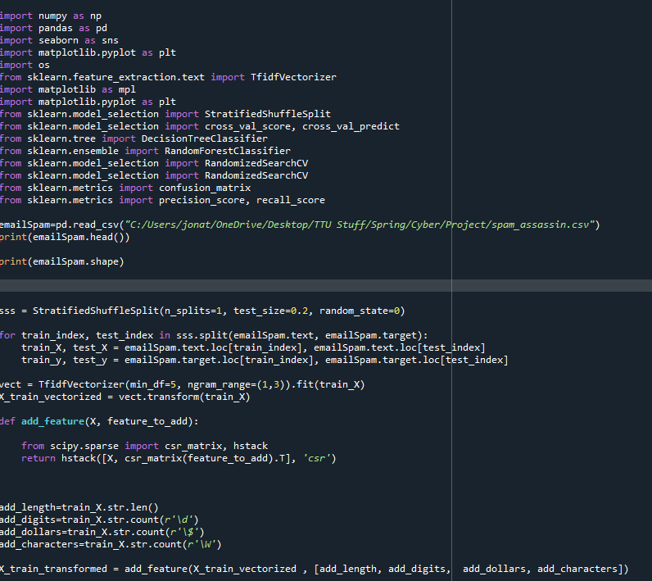
Artifact One: Text Analysis of Email Spam
Began by importing necessary packages Scikit Learn, and Pandas into Python
Data is then Split into training and test sets
Features are generated using the vectorizer for use in text analysis
Notes:
Jonathan

Slide 36
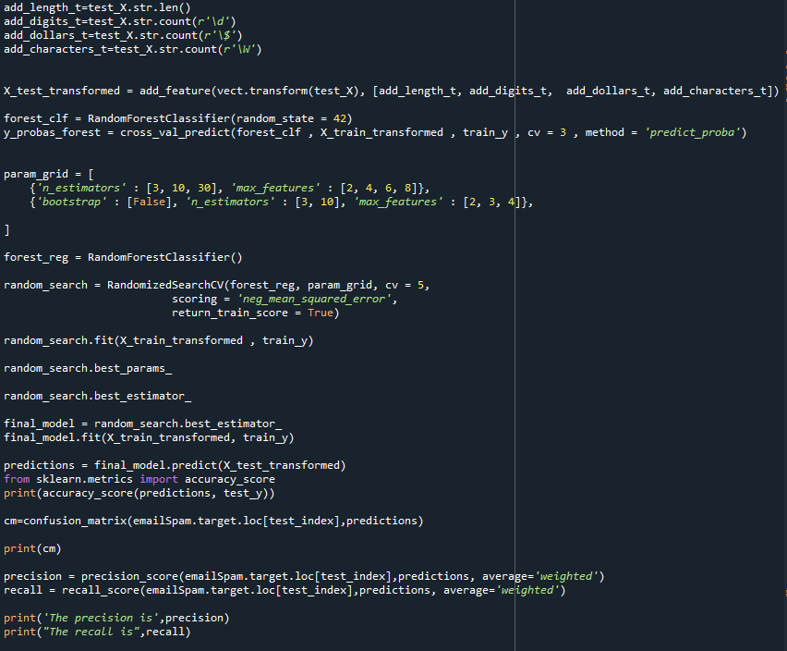
Artifact One: Text Analysis of Email Spam
A model is generated using the random search best estimator
We predict the test data based on the model generated from the training data
We then report the accuracy, precision and recall scores of the model
Notes:
Jonathan

Slide 37
Artifact Two: Classification of Phishing Links
We chose to create an artifact that classifies whether a given link is a phishing link or not
We chose this artifact as the classification of phishing links would allow for any further phishing links to be correctly identified, within an acceptable margin of error, when they are sent to university networks
Any content containing these identified phishing links can then be promptly removed thus protecting universities
Notes:
Jonathan

Slide 38
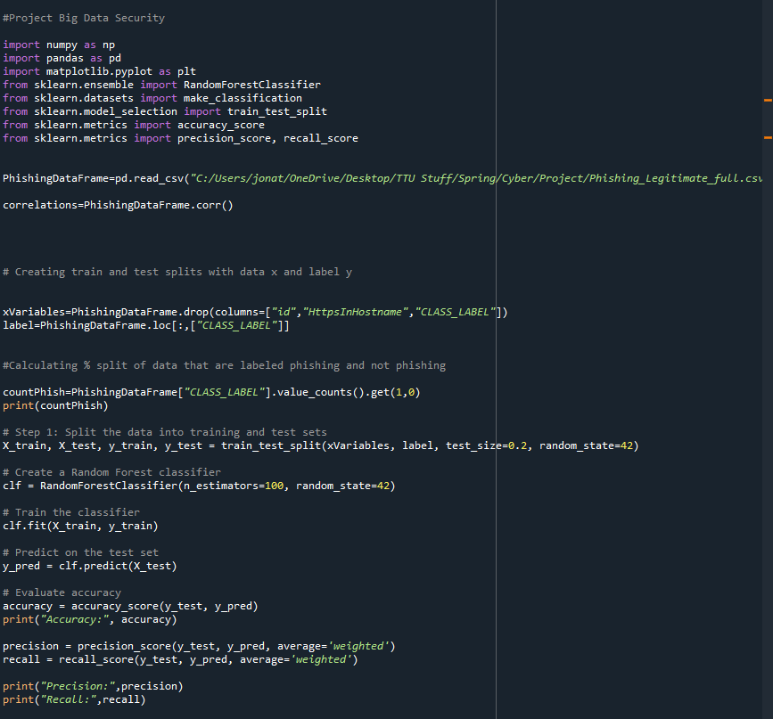
Artifact Two: Classification of Phishing Links
Decided use Python with the pandas, numpy, matplotlib, and scikit-learn packages which we imported
read in the data using read_csv and then split the data into dataframes containing independent and dependent variables
Notes:
Jonathan

Slide 39
Artifact Two: Classification of Phishing Links
The data was then split into both training and test sets with a test size of 20% of the data
A random forest estimator was then used and fitted to the training data
The model was used to predict the classification of phishing links within the test data
We then reported the accuracy, precision, and recall of the model
Notes:
Jonathan

Slide 40
Artifact Three: Input Analysis of URL Length
Input analysis of the distributions of key variables can further protect students and faculty as this would allow another form of analysis to determine whether a link is dangerous or not
Decided to perform analysis of the URL length distribution as this variable was an important factor in identifying if a link was phishing or not
If the parameters of the distributions varied enough, we could test the likelihood that a URL of a particular length came from either distribution
Notes:
Jonathan

Slide 41
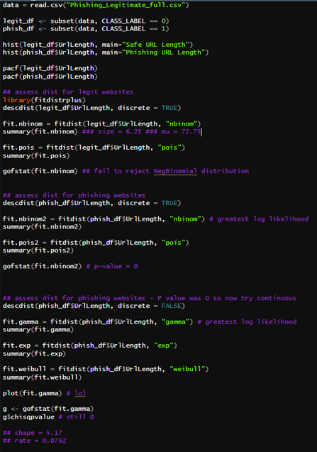
Artifact Three: Input Analysis of URL Length
Chose to use R instead of Python due to our greater experience in performing input analysis within R
Read in the data using the read.csv function and imported the fitdistrplus package
Created an ACF and PACF graph for the URL length variable
Notes:
Jonathan

Slide 42
Artifact Three: Input Analysis of URL Length
Various Distributions were checked
For legit websites, the negative binomial distribution was best with a Size of 6.25 and a Mu of 72.75
A chi squared test was then performed and this distribution held
The phishing link distribution was also negative binomial, but the chi squared test returned a p-value of near zero, therefore we rejected the null hypothesis that this distribution was negative binomial
Notes:
Jonathan

Slide 43
Artifact Presentation

Slide 44
Artifact One: Text Analysis of Email Spam
After we fit our model to the training data, we evaluated our model on three different metrics: accuracy, precision, and recall.
The model shows promise for real world implementation, especially in the use of places of higher education having a goal of reducing spam mail for students and faculty
Method | Score
Accuracy | 0.99
Precision | 0.99
Recall | 0.99
Notes:
Emily

Slide 45
Artifact Two: Classification of Phishing Links
We evaluated our phishing link classification model the same way as we did our text analysis model.
It scored highly on every method of evaluation, and again, would be very useful in detecting illegitimate websites, one of the leading cybersecurity concerns in the education industry.
Method | Score
Accuracy | 0.98
Precision | 0.98
Recall | 0.98
Notes:
Emily

Slide 46
Artifact Three: Input Analysis of URL Length

Slide 47
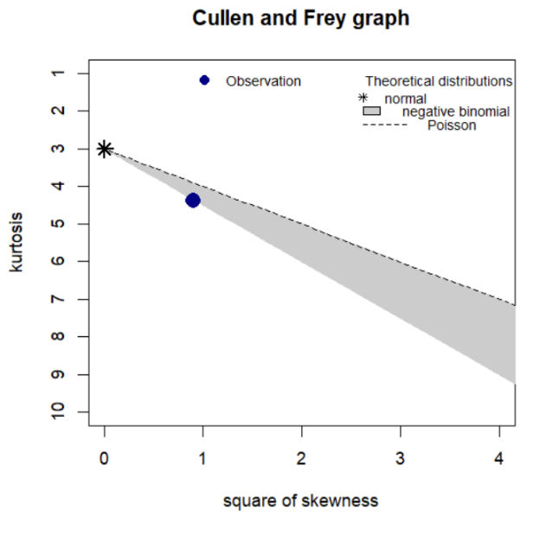
Input Analysis for URL Length (Legitimate)
Potential candidates for the distribution were negative binomial and Poisson
We fit the legitimate subset of data to these two distributions to determine which one was the best fit
Notes:
Emily

Slide 48
Input Analysis for URL Length (Legitimate)
Distribution | Log-Likelihood | P-Value
Negative Binomial | -23872 | 0.1623
Poisson | -46409 | N/A
We went with a Negative Binomial distribution as it had the greater log-likelihood.
Seeing that the p-value is greater than 0.05, we fail to reject the null hypothesis that the URL length is a negative binomial distribution
Notes:
Emily

Slide 49
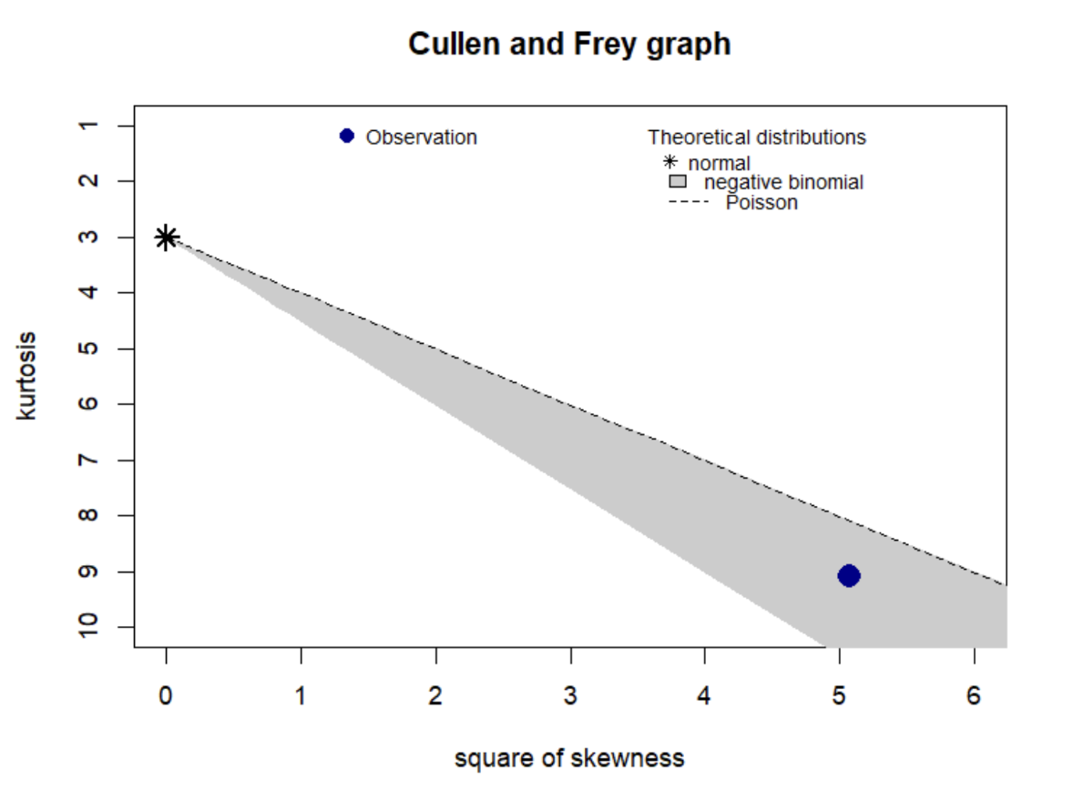
Input Analysis for URL Length (Phishing)
The Cullen and Frey graph suggests the same distributions for the phishing website URLs, either negative binomial or Poisson.
Notes:
Emily

Slide 50
Input Analysis for URL Length (Phishing)
Distribution | Log-Likelihood | P-Value
Negative Binomial | -23766 | 0
Poisson | -52561 | N/A
Again, we assessed the distributions and negative binomial was the best fit.
Although it was the best fit, we have a p-value of 0, so we must reject the null hypothesis that the distribution of URL length for phishing websites is negative binomial.
Notes:
Emily

Slide 51
Input Analysis Conclusion
By acknowledging these distributions, we can gain valuable insights into some key differences between legitimate and phishing websites.
Legitimate websites tend to prioritize usability.
Phishing websites tend to prioritize deception, which can include the
manipulation of URL structures to hide their true intentions, which can then cause the distribution of URL lengths to lack discernible patterns.
It is a key observation to realize that legitimate URLs follow
a distribution pattern, while phishing URLs do not. Understanding these differences helps in identifying potential threats and the nature of phishing website structures.
Notes:
Emily

Slide 52
Group Roles
Milestone One
James-Part 2 and 3
Emily-Part 2 and Part 4
Jonathan-Part 1 and Part 2
Milestone Two
James-Part 3
Emily-Part 2
Jonathan-Part 1
Milestone Three
James-Part 1
Emily-Part 3
Jonathan-Part 2
Power Point Work is Respective To Work Assigned in the Milestones

